Slide 1
Workshop: Quality and test
Group 4

Slide 2
1. Criteria for quality attributes
Security – The system allows the user to log in as a manager or an employee using different passwords for security reasons.
Performance – 5 concurrent users searching the product catalogue while the system is on normal operation. Response time is less than 1 second.
Reliability – Probability of unavailability: In case of server failure it takes up to 1 minute for the server to restart or for the system to switch to the backup server.
Within 2 years, the customers may be willing to upgrade to a full local replication of the remote services. The SME says that local client-side services are acceptable until the system reconnects to the server or the system is switched to the backup server.

Slide 3
2. Maintainability as a quality attribute
Low coupling pattern is about: How can we support low dependency between the system classes.
In Western Style we can observe the high coupling pattern between Invoice and SalesOrder because if we change the SalesOrder the Invoice will be automatically changed because of amount and a low coupling pattern would be between Clothing, Equipment, GunReplicas because if we change something inside these classes the Product class won’t be affected. Another high coupling is between Customer and SalesOrder and is called Content coupling because it occurs when one module modifies or relies on the internal workings of another module. Therefore changing the way the SalesOrder module produces data will lead to changing the dependent module.
High Cohesion pattern is about: expresses that the responsibility of a class/component is closely related, and has a short precise description.
In Western Style the high cohesion is present in all classes, because they all contribute to a single well-defined task of the module.

Slide 4
3. System test planning
When a system is going to be accepted by the customer is important that the system is fully functional and with very few bugs or none if possible. It’s also important for the developer to know when a requirement is met.

Slide 5
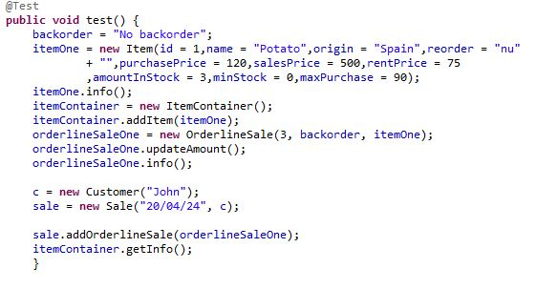
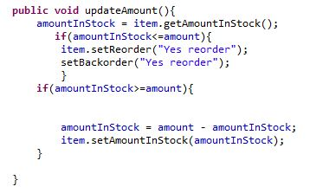
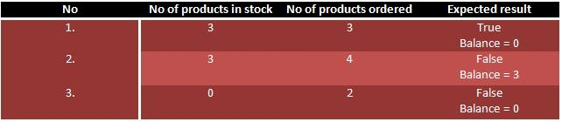
4. Unit and integration test planning

Slide 6
5. Proof-of-concept. Unit and integration test implementation

Slide 7
Ce mai tre sa punem
3.
B.Make suggestions for test scenarios from the use case consider alternative flows.
c.Make suggestions for test cases; one test case for each test scenario
4.
a. Define equivalence classes for amount and amountInStock
b.Make test cases which cover the equivalence classes while using boundary values.

